Slide 1
More Combinatorics
Sections 8.4-8.7

Slide 2
Generating Permutations and Combinations
This is an unusual topics for a discrete mathematics course emphasizing mathematics (rather than computer science), but it introduces two ideas you should be familiar with (as well as a few others that are simply interesting). Those ideas are lexicographic order and the representation of subsets of a set by bit strings (strings of 0’s and 1’s).

Slide 3
Generating Permutations and Combinations
Lexicographic order is just alphabetical order generalized. Suppose you have an “alphabet” A and that the elements of A are totally ordered (like the letter of the English alphabet or the single-digit integers). Suppose further that you have two sequences “words” x and y on A. If x and y are the same, then x=y. If not, then find the first (leftmost) position at which x and y have different letters. If that letter in x is less than the corresponding letter in y, then x<y. Otherwise y<x.
Look at examples.

Slide 4
Generating Permutations and Combinations
You can use lexicographic ordering to order all sorts of sets – for instance the complex numbers. That is a+bi<c+di if a<b or if a=c and b<d. This is equivalent to ordering all the ordered pairs (a,b) of real numbers.
Question: Given the letters a, b, c, d, and e, what is the first word (string, not a dictionary word) you can make using each once? What is the last? What about the digits 1,2,3,4,5,6? What general principles can we draw?

Slide 5
Generating Permutations and Combinations
Note the book’s notation (which is standard) for permutations. For instance 35241 is the permutation that maps 1 to 3, 2 to 5, 3 to 2, 4 to 4, and 5 to 1.
We know that there are 7! permutations on {1,2,3,4,5,6,7}. Suppose we want to list them all. Is there an efficient way to do so? It turns out to be fairly simple to list them lexicographically. The only hard question is, given one permutation, how do we find the next one?

Slide 6
Generating Permutations and Combinations
It is intuitively reasonable that if the final digits of a permutation are in descending order, then no rearrangement will make them larger. For instance in 1257643 we cannot produce a larger number by rearranging the 7643. Instead we must increase the next most significant digit (the 5) by the next larger digit in 7643 (the 6). Then the remaining digits (the 5 and the 743) must be arranged to form the smallest number possible. Thus the next permutation in lexicographic order is 1263457.

Slide 7
Generating Permutations and Combinations
Let us generate the first 10 permutations of {1,2,3,4,5} in lexicographic order.

Slide 8
Generating Permutations and Combinations
Now let us consider generating subsets. Again suppose that A is a totally ordered set with n elements. We can associate with each subset of A a bit-string (string of 1’s and 0’s) by defining the k’th bit to be 1 if the kth element of A is in the subset and 0 otherwise). For instance, if A={a,b,c,d,e,f,g}. Then the subset {a,c,d,g) corresponds to the bit string 1011001, and the word 1100000 corresponds to the subset {a,b}.

Slide 9
Generating Permutations and Combinations
It is intuitively clear that there is a one-to-one correspondence between bit strings of length 7 and subsets of A. Thus we can list all the subsets of A by listing all the bit strings of length 7. This is easy since it involves simple counting from 0000000 to 1111111 in binary.

Slide 10
Generating Permutations and Combinations
Recall that if A={a,b,c,d,e,f,g}, then the subset {a,c,d,g) corresponds to the bit string 1011001 (89 in decimal). The “next” subset corresponds to 1011010 (90 in decimal), and is {a,c,d,f}. Similarly the word 1100000 corresponds to the subset {a,b} and the “next” subset is {a,b,g}, corresponding to 1100001.

Slide 11
Rudiments of Probability
Generally Fermat and Pascal receive the title of founders of probability theory. Though others did some work in the field beforehand, Fermat and Pascal were the first to apply serious mathematics accurately to probabilistic questions. In this section we undertake a very shallow dip in the probability pond.

Slide 12
Four concepts basic to probability
Experiment: An action (e.g., rolling a die) that produces an observable result.
Outcome: A possible result of the experiment. For instance, if we roll a die, then the outcome is the number that comes up.
Sample Space: The set, S, of all possible outcomes of some experiment. For instance if we roll a die, then S={1,2,3,4,5,6}.
Event: A subset of the sample space, usually described in words that have a meaning to us, though this is not necessary. For instance in the case above we could consider the event {2,4,6}, which we can describe as “we roll an even number.” On the other hand {1,2,5} is a perfectly good event, even though it seems to have no simple description.

Slide 13
Four concepts basic to probability
Formally a probability measure P on a sample space S is a function that assigns to every event in S a number (probability) that satisfies several conditions, the first of which is that every such probability must be between 0 and 1. We think of events with probabilities near 0 of being unlikely to happen and with probabilities near 1 of being likely to happen.

Slide 14
Four concepts basic to probability
Let S be a finite sample space. We can get a probability measure P on S by defining P(A)=|A|/|S|, for every event A in S. That is, we divide the number of favorable outcomes by the total number of outcomes. This probability model is appropriate whenever all the outcomes in S are “equally likely” (often problems indicate this by saying an outcome is chosen “at random”) and is inappropriate otherwise.

Slide 15
Four concepts basic to probability
Example: The probability of rolling an even number on a die is 3/6=1/2.
Example: The probability of rolling a sum of 5 on two dice is 4/36=1/9.

Slide 16
Four concepts basic to probability
Thus the finding of probabilities in the case of equally likely outcomes is simply a matter of counting correctly. This is why enumeration invariably accompanies introductory treatments of probability.
Example: A club has 12 boys and 9 girls for members. If they randomly choose 5 members to represent the club at the national convention, what is the probability that all are boys?

Slide 17
Four concepts basic to probability
Theorem 8.54 is the probabilistic equivalent of the addition rule for counting, and Theorem 8.58 is the probabilistic equivalent of principle of inclusion and exclusion for counting.
Theorem 8.55b tells us that the probability something does not happens is one minus the probability that it does. For instance, if a husband and wife have four children, the probability that at least one is a boy is 1–P(all girls)=1–1/16=15/16.

Slide 18
Sequences with Prescribed Frequencies
It is probably best not to read section 8.6. It uses notation that I have never seen for these concepts, and it introduces the concepts in a way that seems guaranteed to be confusing.

Slide 19
Sequences with Prescribed Frequencies
Suppose we wish to count the distinct words that can be formed from 3 A’s and 7 B’s. Words are different if they look different and not otherwise (i.e., you do not get a different word by swapping the positions of two A’s). This is easy. Mark off ten places to receive the letters _ _ _ _ _ _ _ _ _ _. Now choose 3 places to receive A’s. There are C(10,3) ways to do this. Finally fill all the remaining places with B’s. There is only one way to do this. Thus, by the multiplication rule there are C(10,3) ways to arrange 3 A’s and 7 B’s. Of course we could place the B’s first as well, getting the equivalent answer C(10,7).

Slide 20
Sequences with Prescribed Frequencies
In general, if we want a sequence of m objects in which r are of one type and s are of the other type (so r+s=m), then there are C(m,r)=C(m,s) sequences. Equivalently, there are C(m,r) ways to place m labeled balls in two labeled urns such that the first urn gets r balls and the second urn gets s balls.

Slide 21
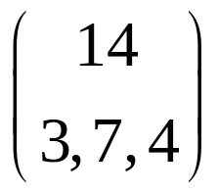
Sequences with Prescribed Frequencies
Now suppose we want to count sequences of 3 A’s, 7 B’s and 4 C’s. First we mark off 14 places to receive the letters. We choose 3 of the 14 positions to receive A’s and then 7 of the remaining 11 positions to receive B’s, the remainder receiving C’s. This yields C(14,3)C(11,7) sequences. If you do the algebra, you will see that this number equals 14!/(3!7!4!). The standard notation for this number is
It is called a trinomial coefficient.

Slide 22
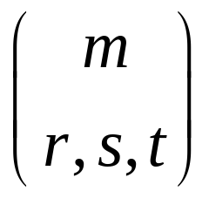
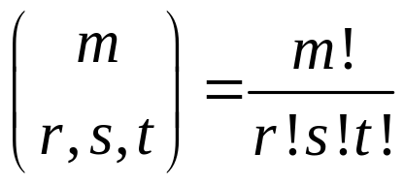
Sequences with Prescribed Frequencies
More generally we define the trinomial coefficient
where m,r,s,t are nonnegative integers with m=r+s+t by
This counts the number of distinct sequences of m objects in which r are of one type, s of a second type, and t of a third type. Equivalently, this counts the number of ways to place m labeled balls in three labeled urns so that the first urn gets r balls, the second gets s balls, and the third gets t balls.

Slide 23
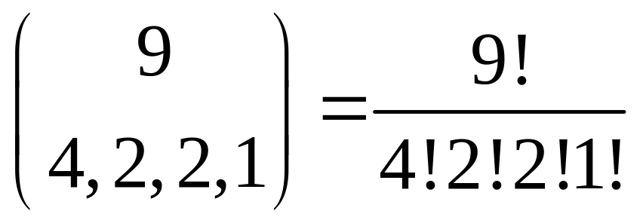
Sequences with Prescribed Frequencies
This idea generalizes to multinomial coefficients. For instance, suppose we want to count the visually distinct sequences of the letters in TENNESSEE (which has 4 E’s, 2 S’s, 2 N’s, and 1 T). The number is

Slide 24
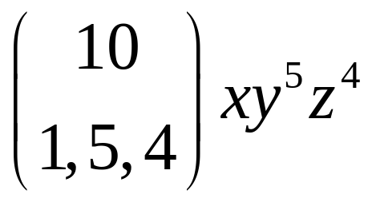
The Multinomial Theorem
Just as there is a binomial theorem for expanding (x+y)^{n}, there is a trinomial theorem for expanding (x+y+z)^{n} and, more generally, a multinomial theorem. For instance, the expansion of (x+y+z)¹⁰ includes the term

Slide 25
The Gumdrop Problem
Again I suggest you not read the book in section 8.7 as I fear it will produce more confusion than enlightenment.

Slide 26
The Gumdrop Problem
Suppose you have 10 identical gumdrops to give to your three children. In how many different ways can you do this? Ways are different if the children would judge them as different. That is it matters only how many gumdrops each child gets. It turns out that there is a one-to-one correspondence between assignments of the gumdrops and sequences of 10 gumdrops and 2 sticks in the following fashion: The gumdrops to the left of the first stick go to the first child; the gumdrops between the sticks go to the second child; and the gumdrops to the right of the second stick go to the third child.

Slide 27
The Gumdrop Problem
For examples, suppose the first child gets 5 gumdrops, the second gets 3, and the third gets 2. This corresponds to the sequence *****|***|**. Similarly, the sequence |****|****** corresponds to the first child getting 0, the second getting 4, and the third getting 6. This is a sequence of 12 objects in which 10 are of one type and 2 are of another, so there are C(12,2)=C(12,10) ways to distribute the gumdrops.

Slide 28
The Gumdrop Problem
Suppose you add the practical restriction that each child must get at least one gumdrop. Make sure you satisfy this condition by giving each child 1. Now distribute the remaining 7 gumdrops among the 3 children. By the same reasoning as above, there are C(9,2)=C(9,7) ways to do this.

Slide 29
The Gumdrop Problem
We can also recast this example as follows: How many solutions does the equation n₁+n₂+n₃+n₄=7 have among the nonnegative integers? (e.g. 4+0+2+1=7). Here we can think of n₁ being the number of apples, etc. We see that in general the equation n₁+n₂+…+n_{k}=n has C(n+k–1,k–1) nonnegative integer solutions and C(n–1,k–1) positive integer solutions. (it is dividing n gumdrops among k children; the ith child gets n_{i} gumdrops).

Slide 30
The Gumdrop Problem
Example: A store sells apples, oranges, pears, and kiwis. If you want to buy seven pieces of fruit, how many options do you have? How many options if you want to buy at least one of each kind?

Slide 31
The Gumdrop Problem
Example: A store sells apples, oranges, pears, and kiwis. If you want to buy seven pieces of fruit, how many options do you have? How many options if you want to buy at least one of each kind?

Slide 32
The Gumdrop Problem
Example: How many positive integer solutions are there to n­₁+n₂+n₃+n₄=23 in which n₂>5 and n₃>10?

